Slide 1
Supply and demand
Alfred Marshall

Slide 2
Market Theory - Alfred Marshall (1842-1924)
Supply and demand according to Alfred Marshall (1942-1924) can be described as a model in economics which precisely determines the price of the goods and services in the market (Kirzner, 1963).
This works in conjunction with the theory of market which explains that market supply and market demand all are controlled by some specific factors which emanate from the supply and demand chains.
Notes:
It also means that theory of market states that whenever there is a high market demand, the market supply should also be increased so that market equilibrium may be achieved.

Slide 3
Additionally, supply and demand should work together to determine how the theory of market works and how the customers and suppliers should interact with each other.
There is also a conclusion that at all times the demand of goods and services in the market should not exceed the market supply as this will lead to a market deficiency which leads to disequilibrium (Kirzner, 1963).

Slide 4
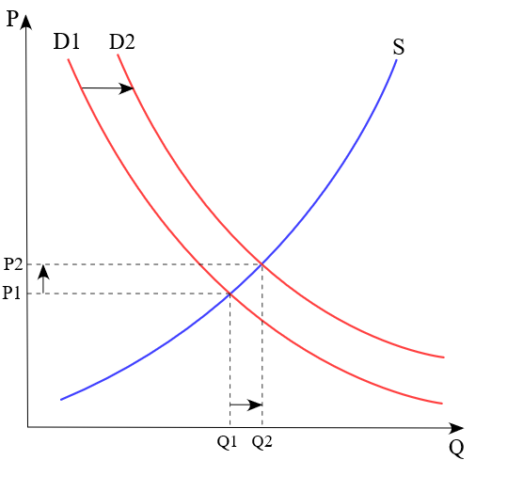
Notes:
The above graph shows the theory of supply and demand whereby the price increases with the increase in supply.

Slide 5
Demand Theory- Factors that cause Changes in Demand and Quantity demanded
Demand theory describes the relationship between the demand of consumers and their prices (Riley, 2015).
This means that a customer can alter their rate of demand depending on the price of a certain product.
Notes:
When the availability of a product increases; its demand drops as well as its equilibrium price.
Therefore, the less available a product is, the more its prices increase as well as its demand.

Slide 6
Supply Theory- Factors that cause Changes in Supply and Quantity supplied
The theory of supply states that as the price of a certain product increases in the market, so does its supply.
This means that suppliers and producers tend to produce more products when their prices are high so that they may benefit fully from the demand in the market.
Notes:
For instance, if the prices of a particular product increase, consumer demand is likely to drop because most customers prefer to increase their demand when prices are low (Riley, 2015).

Slide 7
For instance, when a certain firm notices that a certain product’s price has increased, they tend to increase its production so that they may sell more and achieve higher profit margins.
Therefore, changes in supply and quantity supplied are highly determined by the price and demand of a product in the market.
Notes:
The supply theory is basically explained further by use of a supply curve which shows how the price of a product affects its supply.

Slide 8
How Changes in Supply and Demand affect Market Price and Quantity
Whenever a market is at equilibrium, there is a clear indication that the price of products also stays at equilibrium.
Hence, this can be altered by the changes in supply and demand which are likely to change the price and quantity of a product as well.
Notes:
For example, increase in supply of a certain product leads to increase in its price and quantity.

Slide 9
This is because producers and suppliers tend to increase production of a certain product whenever its price rises (Shailes, 2018).
This therefore affects the demand negatively as it reduces due to the high price.
Most customers prefer to demand more of a product only when its price is low.
Notes:
On the other hand, a decrease in supply means that there is less demand in the market and this leads to low production hence reducing the quantity for a product in the market (Shailes, 2018).

Slide 10
Implications of Tax on both Supply and Demand
High taxation by the government reduces the supply because firms find it more expensive to produce products at a high cost.
Therefore, taxes usually lower both demand and supply within the market; as well alter the market equilibrium into higher prices and lower quantities of products (Humphrey, 1992).

Slide 11
Taxation involves the buyer and the seller to pay an amount of money responsible for the sale of the product in the market.
Therefore, higher taxes lead to low demand as products become more expensive.
Notes:
Higher taxes also lead to a low supply of goods and services into the market because of the high cost of production.

Slide 12
Black market and Government’s Response and how the laws create Higher Risks for Suppliers
Black market involves the buying and selling of goods and services within the market illegally or through illegal means (Laughlin, 1981).
Therefore, the government has come up with laws to counter this practice and decrease it to minimal levels.

Slide 13
These laws do not favor the suppliers and therefore they are all under higher risks of selling goods and services under the black market perspective.
Whenever a supplier is found being involved in the black market businesses, they stand a chance of being jailed and all of their goods being taken into the possession of the government (Laughlin, 1981).
Notes:
This leads to their termination as well as their freedom to enjoy free supply of products into the market.

Slide 14
References
Humphrey, T. M. (1992). “Marshallian Cross Diagrams and Their Uses before Alfred Marshall.” Economics Review.
Kirzner, I. M. (1963). “Market Theory and the Price System.” Liberty Fund.
Laughlin, B. (1981). “Black Markets around the World.” Loom Panics Unlimited.
Riley, G. (2015). “Theory of Supply.” Economics.
Shailes, K. (2018). “Top 14 Contributions of Alfred Marshall to Economics.” Economics Discussion.

